Slide 1
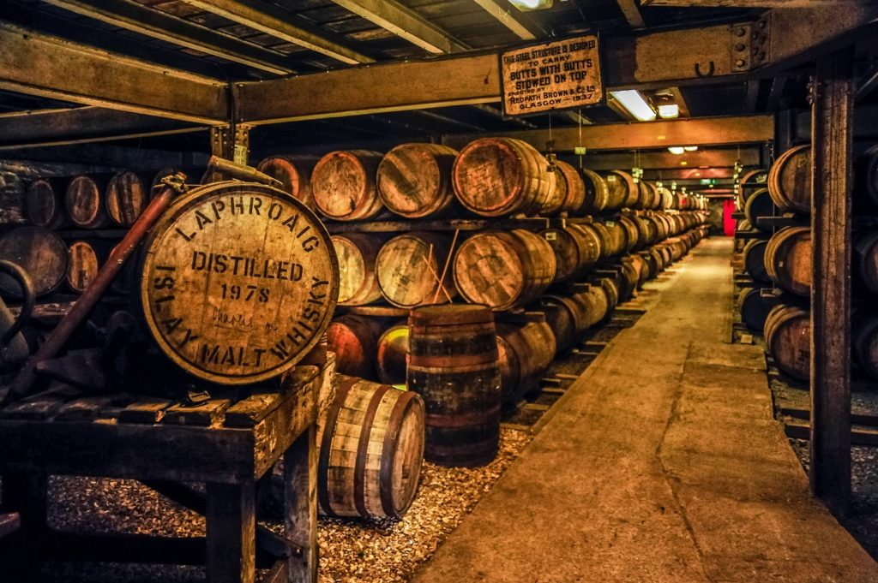
Guide to choose the right Whiskey
“Whiskey is Liquid sunshine.”
-George Bernard Shaw
Presented by:-
Tushaar Sharma

Slide 2
Introduction
Whisky or whiskey is a type of distilled alcoholic beverage made from fermented grain mash. Whisky is typically aged in wooden casks, generally made of charred white oak.
Whisky is distilled throughout the world, most popularly in Scotland, Ireland, the United States, and Japan. It comes in many styles and some countries have strict regulations regarding its production.
The main difference between scotch and whisky is geographic, but also ingredients and spellings. Scotch is whisky made in Scotland, while bourbon is whiskey made in the U.S.A, generally Kentucky. Scotch is made mostly from malted barley, while bourbon is distilled from corn.

Slide 3
Data
Analysis is based on a dataset of user reviews of different brands and bottles of whiskies .
name: Name on the bottle
category : (e.g., Single Malt/Blended)
review.point : Points out of 100 given by each reviewer
price : price of the bottle
currency : Unit of price (e.g. $ dollars)
description : Bottle review (Adjectives defining the ingredients etc.)

Slide 4
Exploring Data
The mean price for a good/expensive whisky was around $570.
The minimum age of a scotch whisky starts from 3 years, which is the minimum maturation time before a spirit can be called (Scotch) whisky.
Source: https://scotchwhisky.com/magazine/ask-the-professor/8033/whisky-and-maturity-why-three-years/
Alcohol by Volume (ABV) minimum value is 40% which is minimum percentage for a (Scotch) whisky according to Scottish regulations.
Source: https://flaviar.com/blog/alcohol-content-in-whisky
The above points indicated the data was extracted correctly as seen in the following data visualizations.

Slide 5
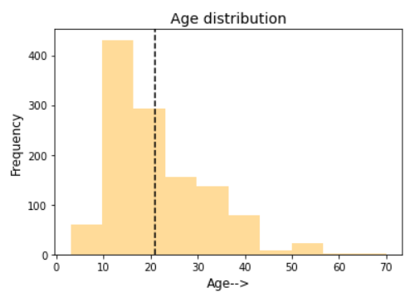
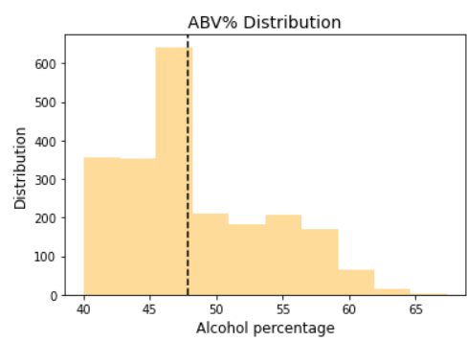
Age and ABV Distribution

Slide 6
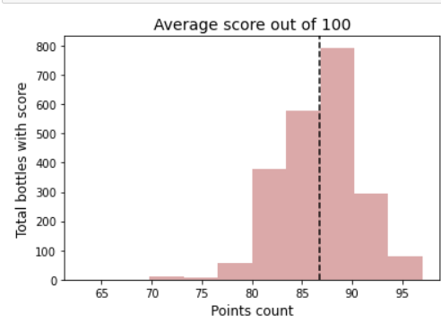
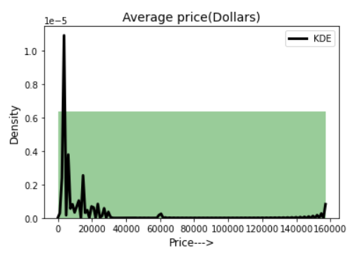
Price and Review Points Distribution
The review points graph on the left also braces the famous quote by Raymond Chandler (Novelist and screenwriter).
“There is no bad whiskey. There are only some whiskeys that aren’t as good as others.”

Slide 7
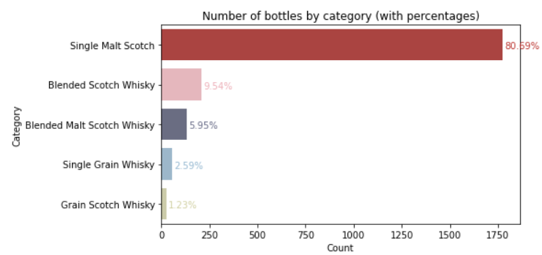
Whisky Categories and their distribution

Slide 8
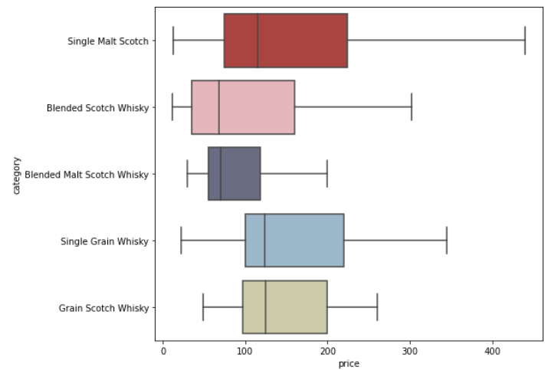
Comparison of mean price for all categories
Blended and Blended malt scotch whiskies have a similar median price which is approximately 50 dollars lower than the rest of the categories.

Slide 9
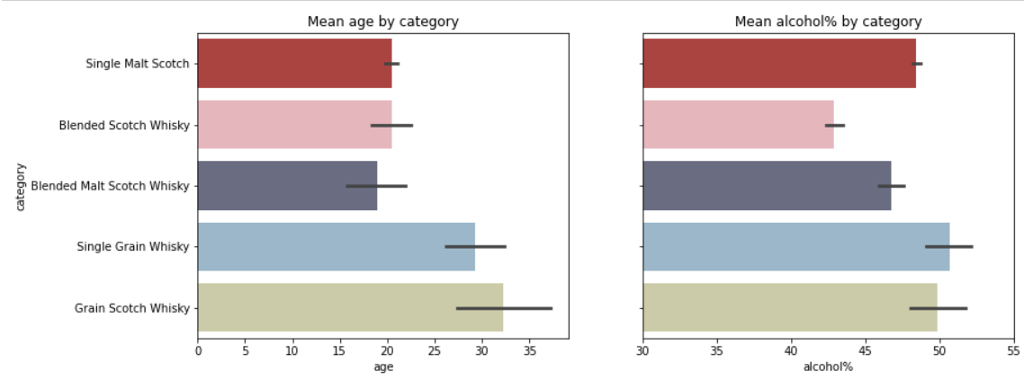
Price and alcohol percentage(ABV) comparison
Single Grain and Grain Scotch whiskies are preserved for the longer durations in terms of mean age.
Single Grain Whisky has the highest alcohol percentage.

Slide 10
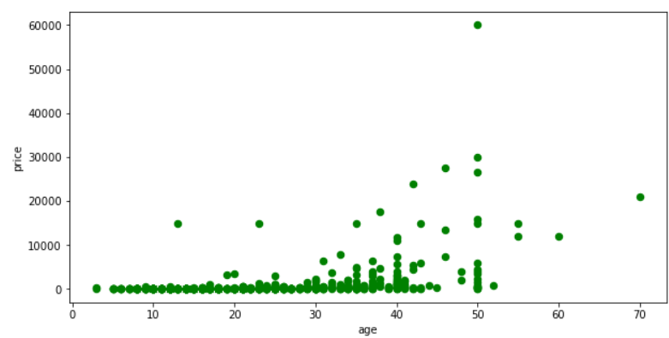
Variation of price with age of the whisky
The price may not always increase with age as it may also depend on other external factors like brand name, distillery etc.

Slide 11
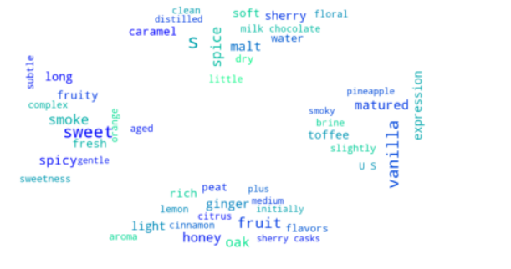
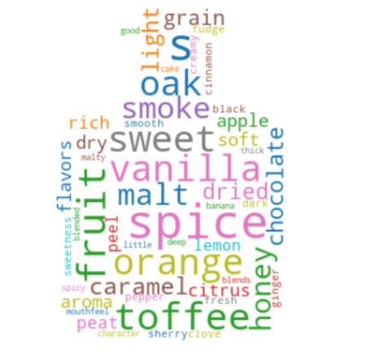
The most common ingredients/flavours/tastes used to describe a single malt and blended whisky
Single Malt Whisky
Blended Whisky
Does the image below remind you of something?

Slide 12
Other Interesting Facts in the data set:
Diamond Jubilee by John Walker & Sons, with 42.5% was the most expensive whisky priced at $157000.
Three whiskies almost touch perfection, scoring 97 points! The most affordable of the three is Johnnie Walker Blue Label priced at $225.
The Gordon & MacPhail Generations: Glenlivet is the oldest bottle with an age of 70 priced at $21000.
Monarch of the Glen is the most affordable option with a price of only $12 dollars.

Slide 13
Conclusions
There are five categories of whiskies: Single Malt, Blended whiskies, Blended Malts, Single Grain whiskies and Grain whiskies.
The most popular and widely sold category are the Single Malts.
Blended Malt whiskies receive a higher score on an average.
If one likes strong whiskies go for the Single Grain or Grain whiskies having a higher age and highest alcohol content.
Check the ingredients of your whiskey. If one likes a subtle, floral, matured, soft taste go for the Single Malt and if one enjoys a smooth, creamy, dark style choose a Blended Malt.

Slide 14
Thank you for your time!

